Slide 1
Azure DevTest Labs
With Open Source Tools
Notes:
© Copyright PresentationGo.com – The free PowerPoint library

Slide 2



Eric Leonard
Solutions Architect
Cistel Technology Inc.
Twitter: @erleonard
LinkedIn: https://www.linkedin.com/in/erleonard/
Website: http://erleonard.me
GitHub: https://github.com/erleonard
Notes:
© Copyright PresentationGo.com – The free PowerPoint library

Slide 3
Agenda
Deployments
Artifacts with KeyVault
Formulas, Policies, Custom Images
Integration with Visual Studio Team Sites
Creating and Using GitHub repositories
Cost Management
Notes:
© Copyright PresentationGo.com – The free PowerPoint library

Slide 4
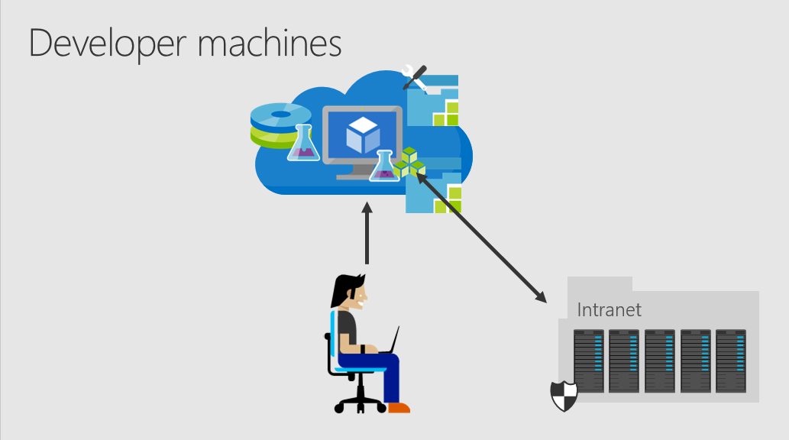
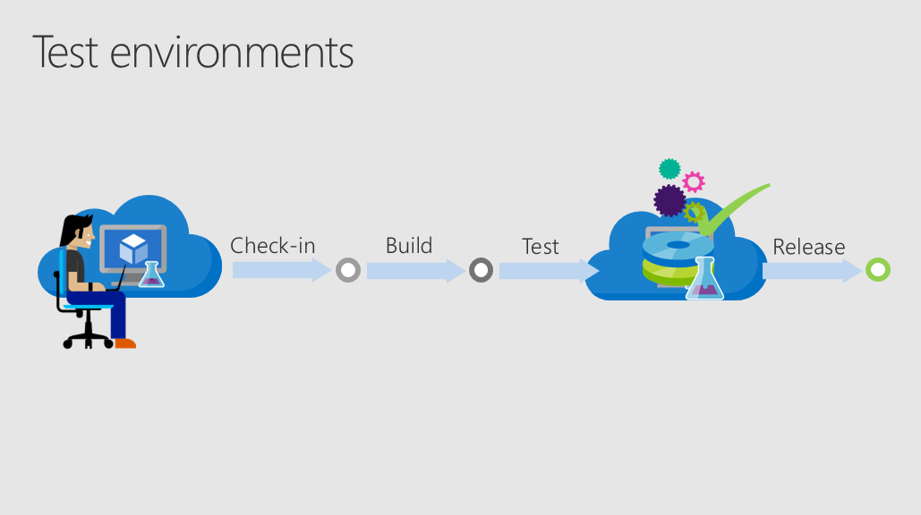
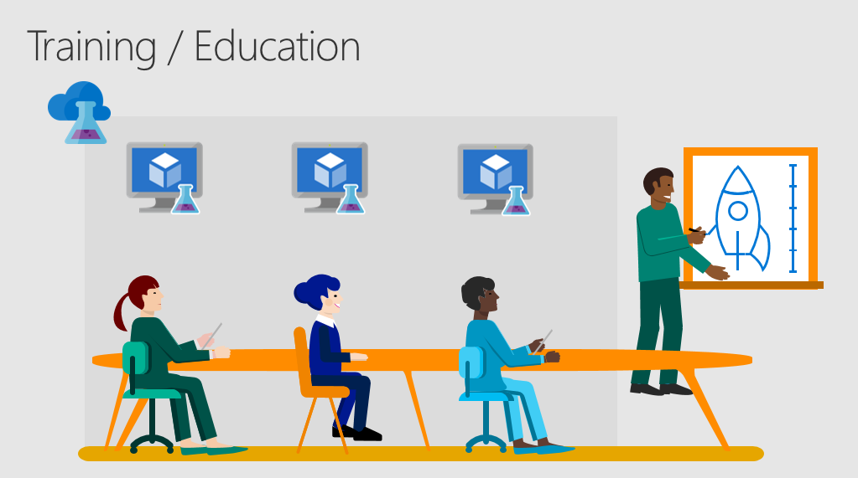
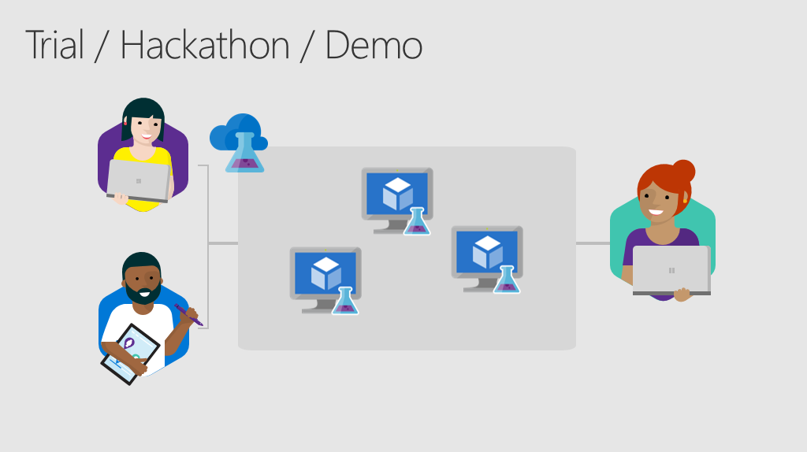
Scenarios
Notes:
© Copyright PresentationGo.com – The free PowerPoint library

Slide 5
DEMO

Slide 6
Notes:
© Copyright PresentationGo.com – The free PowerPoint library

